Slide 1





New York Stock Exchange Data Analysis

Slide 2
1
Introduction

Slide 3

What is the Purpose of this Analysis?
Help individuals interested in investing in stocks
Be able to see data in stock trends
Help make more informed decisions
More visual format

Slide 4
Questions for Analysis:
1.
What date did Aetna Inc have the highest "high" in 2016?
2.
Which company had the lowest "low" in March of 2013?
3.
What was the average gross profit of General Motors between 2013 and 2016?
4.
What was the average total revenue of Amazon.com Inc from 2013 to 2016?
5.
What was the total liability of Netflix Inc. in 2014?

Slide 5
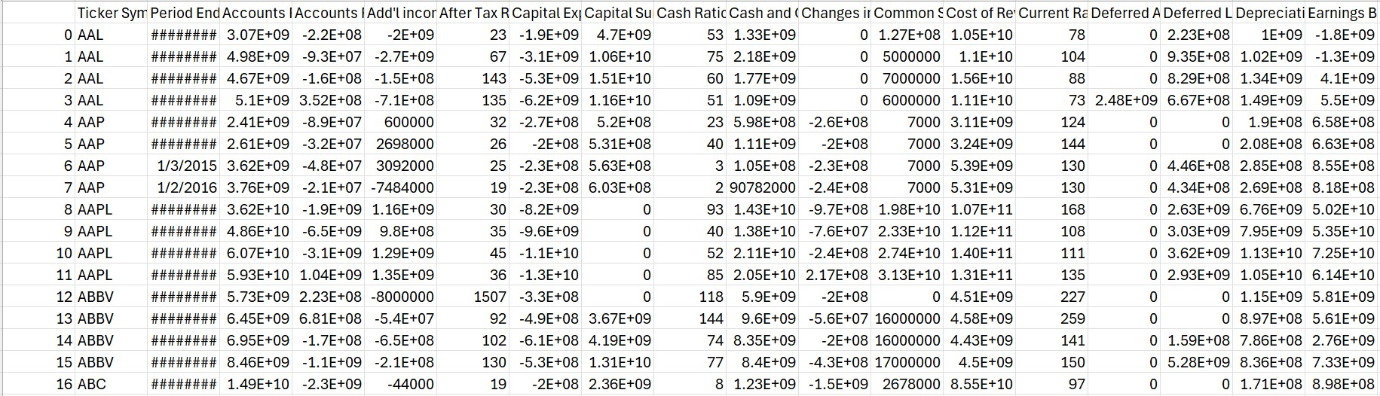
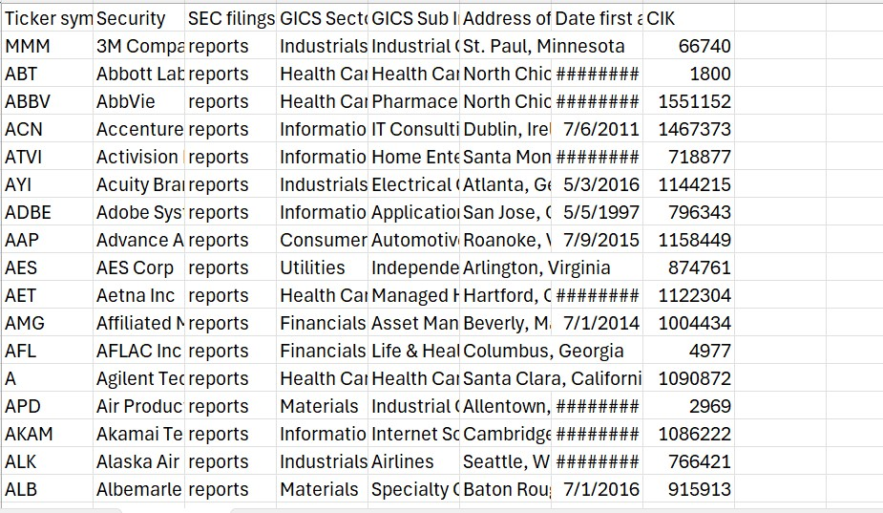
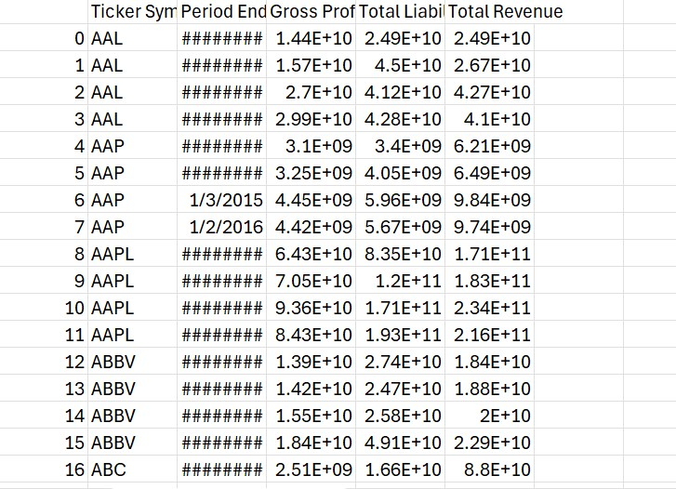
Methodology: Datasets Used
Original Datasets from Kaggle:
Datasets were Cleaned and Used in Further Sections of Project:

Slide 6
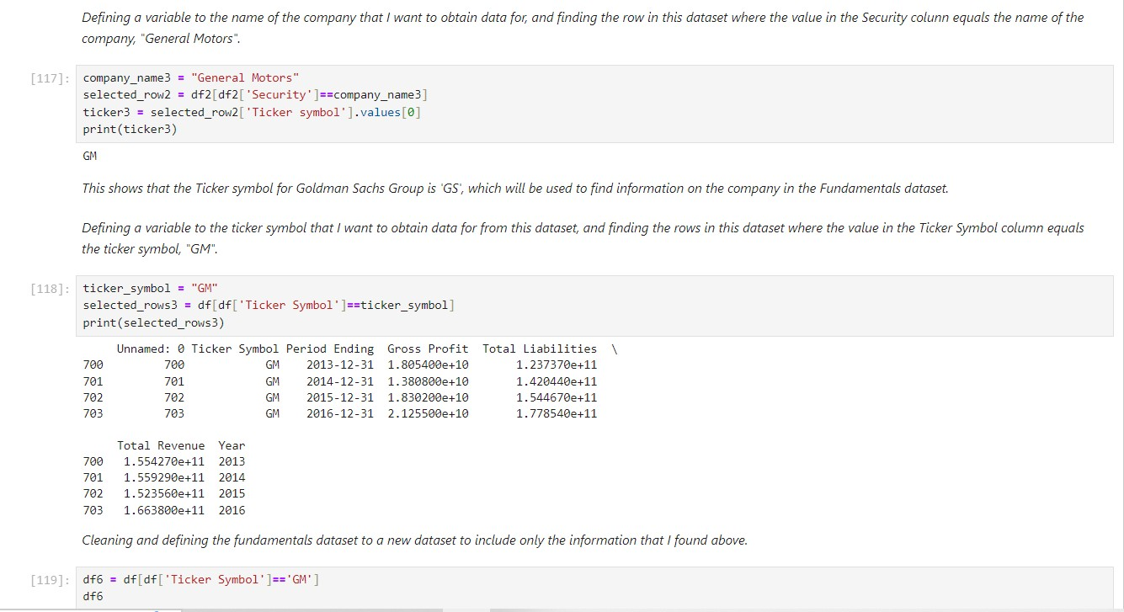
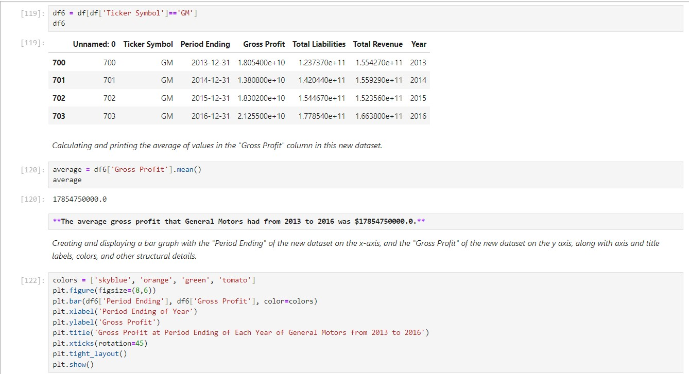
Tools and Functions Used:
Jupyter Notebook and Anaconda Navigator
Python Packages: pandas, matplotlib.py
Sample of Code:

Slide 7
Answers to Questions:
- Question 1 Answer: Aetna Inc had the highest high in 2016 on December 2nd, 2016.
- Question 2 Answer: The company with the lowest low in March of 2013 was Frontier Communications.
- Question 3 Answer: The average gross profit that General Motors had from 2013 to 2016 was $17,854,750,000.0.
- Question 4 Answer: The average total revenue of Amazon from 2013 to 2016 was about $101,608,250,000.0.
- Question 5 Answer: The total liabilities of Netflix Inc. in 2014 was 5,184,792,000.0.

Slide 8
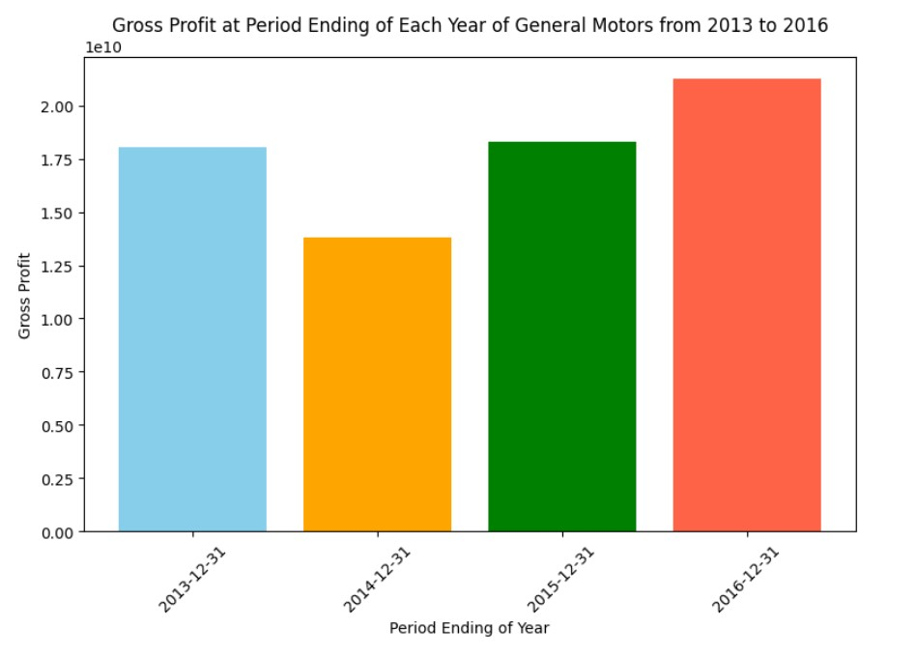
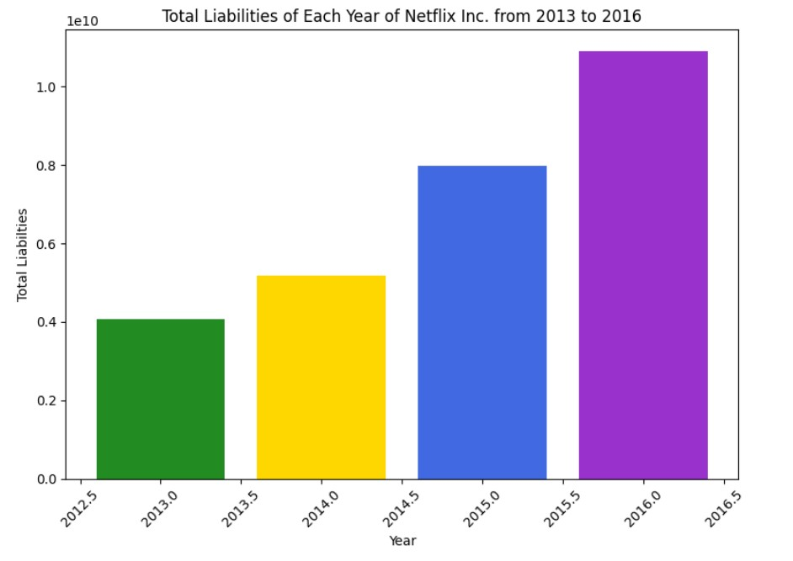
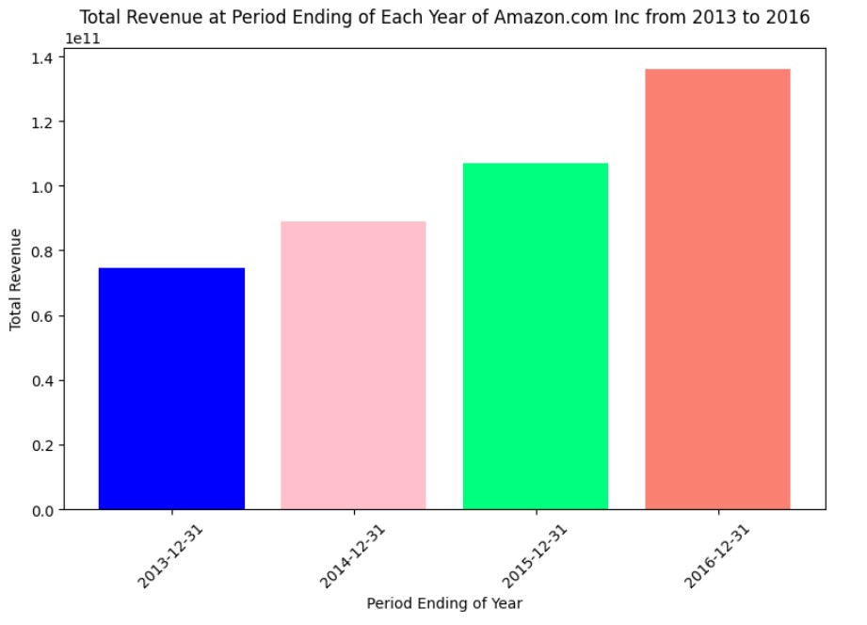
Bar Plots of Answers

Slide 9
Insights Gained
- Often need to clean data during analysis
- Need to change structure of dataframes to answer questions
- Outside Help

Slide 10
Future Work
- Like Use current data through webscraping
- Create Program to get User Input
- Display Returns for date and/or revenue and liability

Slide 11
Sources Used
Kaggle Source: https://www.kaggle.com/datasets/dgawlik/nyse
Cleaned CSV files:
..\Documents\CMP-262 Spring 2024\Fundamentals_Cleaned.csv
..\Documents\CMP-262 Spring 2024\Securities_Cleaned.csv
..\Documents\CMP-262 Spring 2024\Prices_Cleaned.csv
..\Documents\CMP-262 Spring 2024\Prices_Split_Adjusted_Cleaned.csv
GitHub Repository Link: https://github.com/estopa24/Final-Project.git
Outside Sources Used: StackOverflow, chatGPT

